Slide 1
TAK Server - Managing Users and Groups

Slide 2
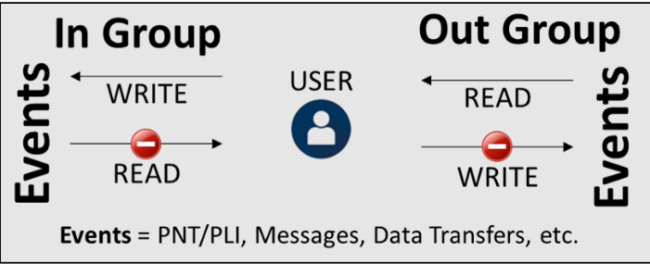
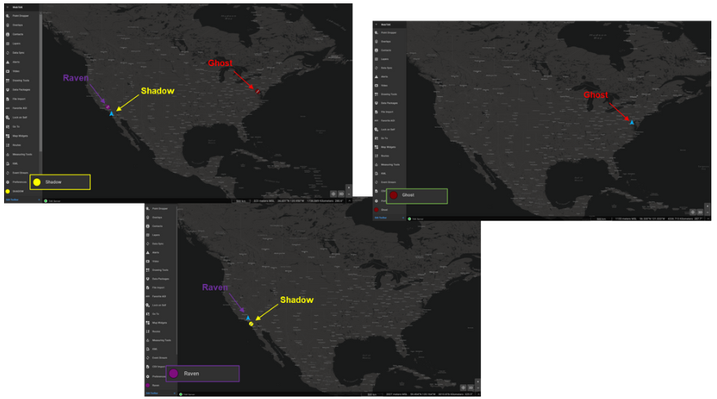
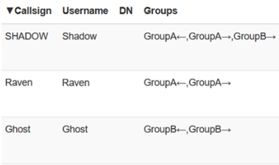
TAK Server - Groups
There are three roles within groups:
In: the user events are transmitted to the group that they are placed in, allowing the user to write to the server but not read.
Out: the user can receive transmitted events from the group they are place in, allowing the user to read messages but not write.
Both: Allows both reading and writing to the server.

Slide 3
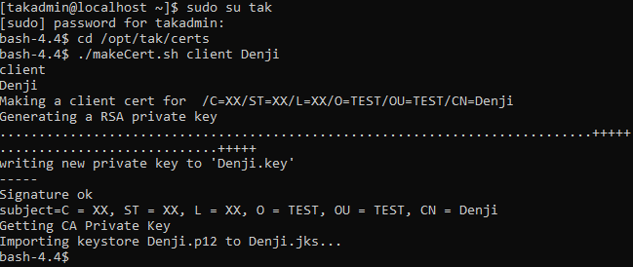
TAK Server - Implementing Groups - Command Line
Change to the tak user
sudo su tak
Navigate to the certificate directory
cd /opt/tak/certs
Create the client certificate
./makeCert.sh client <username>
Example: ./makeCert.sh client Denji

Slide 4
TAK Server -UserManager Usage Instructions:
java -jar UserManager.jar certmod [OPTIONS] certpath
Facilitates the viewing, addition, or modification of the users' using certificates.
Options:
-A, --administrator Provides the user with administrative access
-D, --delete-user Deletes the user. All other optional parameters will be ignored.
-f, --fingerprint FINGERPRINT Overrides the certificate fingerprint
-p, --password PASSWORD The password for the user. Password requirements: minimum of 15 characters to include 1 uppercase, 1 lowercase, 1 number, and 1 special character from this list [-_!@#$%^&*(){}[]+=~`|:;<>,./\?]. NOTE: you may need to surround the password string with single quotation marks

Slide 5
TAK Server -UserManager Usage Instructions:
java -jar UserManager.jar usermod [OPTIONS] username
Facilitates the viewing, addition, or modification of the users using their username.
Options:
-A, --administrator Provides the user with administrative access
-c, --certificate CERTPATH The filepath to the certificate that contains the user's fingerprint. If the fingerprint is specified as a command line option, this will be ignored!
-D, --delete-user Deletes the user. All other optional parameters will be ignored.
-f, --fingerprint FINGERPRINT The fingerprint the user can use to authenticate with
-p, --password PASSWORD The password for the user. Password requirements: minimum of 15 characters to include 1 uppercase, 1 lowercase, 1 number, and 1 special character from this list [-_!@#$%^&*(){}[]+=~`|:;<>,./\?]. NOTE: you may need to surround the password string with single quotation marks

Slide 6
TAK Server -UserManager Usage Instructions:
To add a user to a specific group:
Both Group:
UserManager.jar certmod -g <groupName> /opt/tak/certs/files/<commonName>.pem
Example: UserManager.jar certmod -g __TAK__ /opt/tak/certs/files/Denji.pem
In Group:
UserManager.jar certmod -ig <groupName> /opt/tak/certs/files/<commonName>.pem
Example: UserManager.jar certmod -ig TAK /opt/tak/certs/files/Denji.pem
Out Group:
UserManager.jar certmod -og <groupName> /opt/tak/certs/files/<commonName>.pem
Example: UserManager.jar certmod -og TEST /opt/tak/certs/files/Denji.pem
To run the script: (While in the tak user)
java -jar /opt/tak/utils/UserManager.jar certmod -g TEST /opt/tak/certs/files/Denji.pem
Note: In the examples different group names were used, if the group doesn’t exist, doing this will create the group.

Slide 7
TAK Server - Implementing Groups - Command Line
Once you are done adding the user to a group you will need to copy over the certificate p12 file if not using auto enrollment.
You are able to move users from groups if you have already issued the certificate by running the previous commands.
With this you will not need to re-create a new cert every time you move, add, or change a user group.

Slide 8
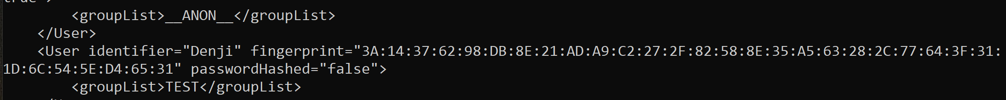
TAK Server - Implementing Groups - Command Line
Removing Users from Groups:
Open and examine the UserAuthentication.xml file:
(As the tak user) cd /opt/tak
vi UserAuthenticationFile.xml
You are looking for the user you wish to remove and their group you wish to remove them from, which will be between:
Both group: <groupList> <group> </groupList>
In Group: <groupListIN> <group> </groupListIN>
Out Group: <groupListOUT> <group> </groupListOUT>
Once you find the group of the user you want to remove them from exit out of the file without editing it:
Press “esc”
:q!
Press enter

Slide 9
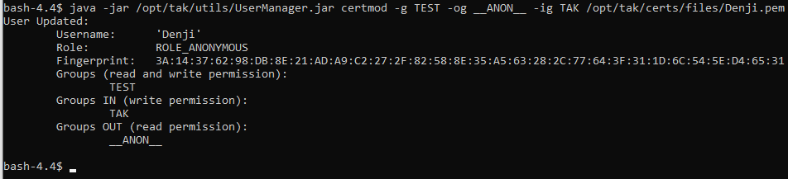
TAK Server - Implementing Groups - Command Line
As the tak user
Remove the user from GroupB but retain GroupA
java -jar /opt/tak/utils/UserManager.jar certmod -g GroupA /opt/tak/certs/files/<user>.pem
Remove the user from GroupA but retain Out Group in GroupB
java -jar /opt/tak/utils/UserManager.jar certmod -og GroupB /opt/tak/certs/files/<user>.pem
To remove a user from a group you only specify the groups you want them to be in and omit the groups you don’t.
You can add them to multiple groups by adding them next to each other as follows:
java -jar /opt/tak/utils/UserManager.jar certmod -g GroupA -og GroupB -ig GroupC /opt/tak/certs/files/<user>.pem

Slide 10
TAK Server - Implementing Groups - Server Dashboard
Open the server dashboard with a web browser and navigate to the Manager Users section:
Top right hamburger menu → Administrative → Manage Users
From here you are able to:
Add users one at a time: Top left, select “Add User” .
Add users in bulk: Top left, select “Add Users”.
Manage groups:
Add new group: Top right, select “Add New Group”.
Search for a group.
View the users in a group: select the group → List users

Slide 11
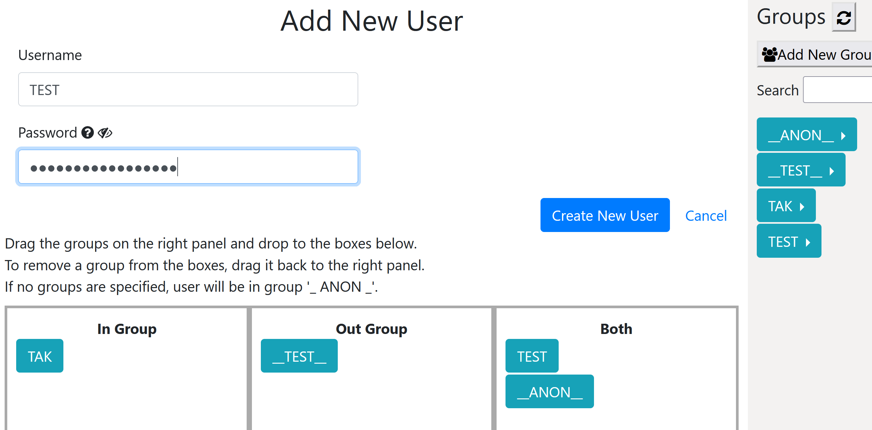
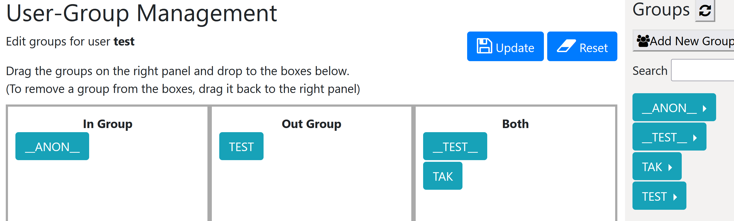
TAK Server - Implementing Groups - Server Dashboard
You can add a new user or select a current user.
New user:
Provide a username and password for them.
On the right drag and drop the desired groups where you’d like them.
When you are done, select “Create New User”
Existing user:
select the user from the “Users” panel and then select “View/Edit groups”.
You can drag and drop the groups currently within the user or from the right hand “Groups” panel to the desired locations.
When you are done, select “Update”

Slide 12
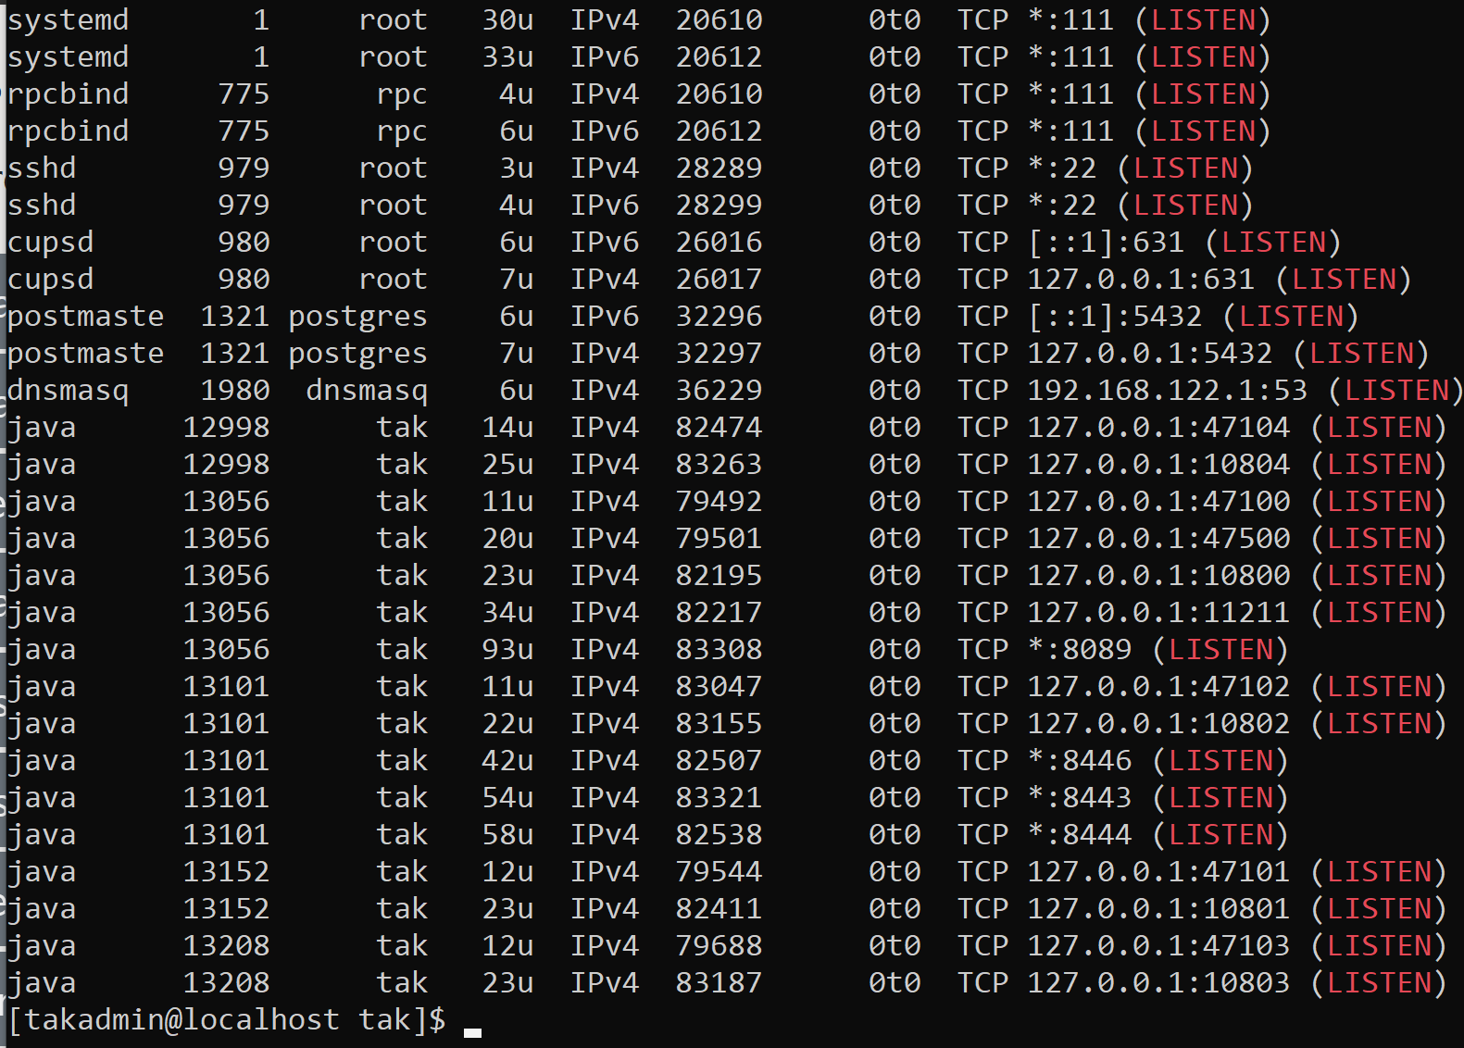
TAK Server - Using Input Based Grouping
Determine Open Ports:
View active listening ports (based on your distro some commands will not be available)
sudo lsof -i -P -n | grep LISTEN
sudo netstat -tulpn | grep LISTEN
sudo ss -tulpn | grep LISTEN
You only need to run one of the above command, which ever works.
We want to identify that the port we have in mind is not already in use.
Example: 8087

Slide 13
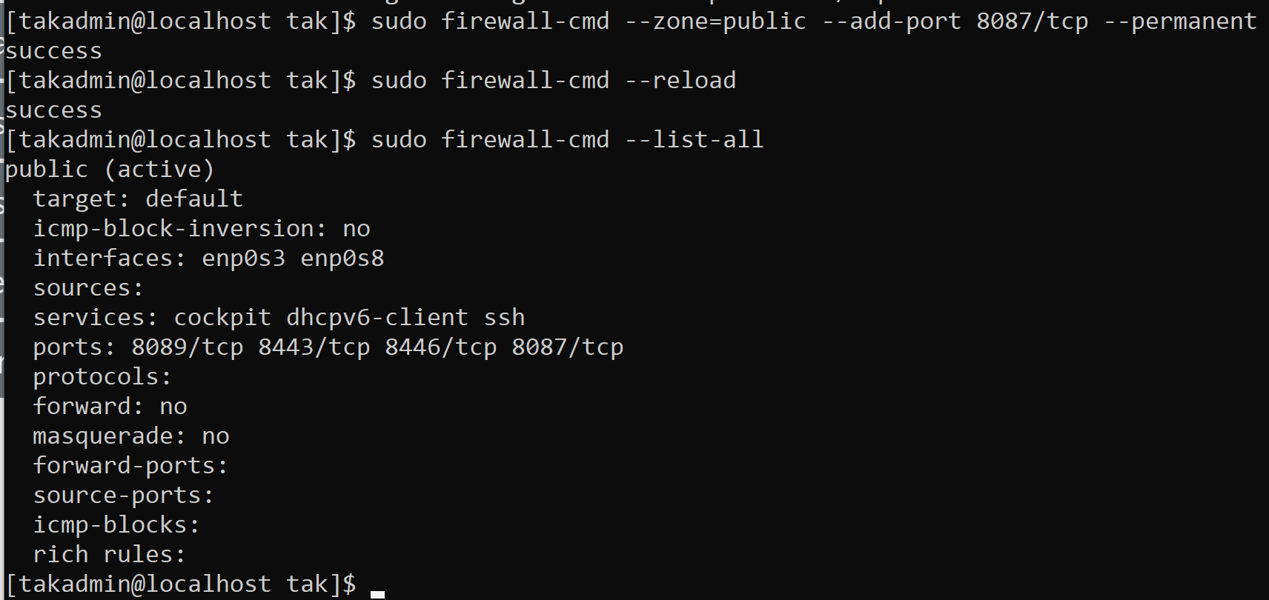
TAK Server - Using Input Based Grouping
Add the port to our firewall:
sudo firewall-cmd --zone=public --add-port 8087/tcp --permanent
Reload the firewall to accept the changes:
sudo firewall-cmd --reload
Verify the changes:
sudo firewall-cmd --list-all

Slide 14
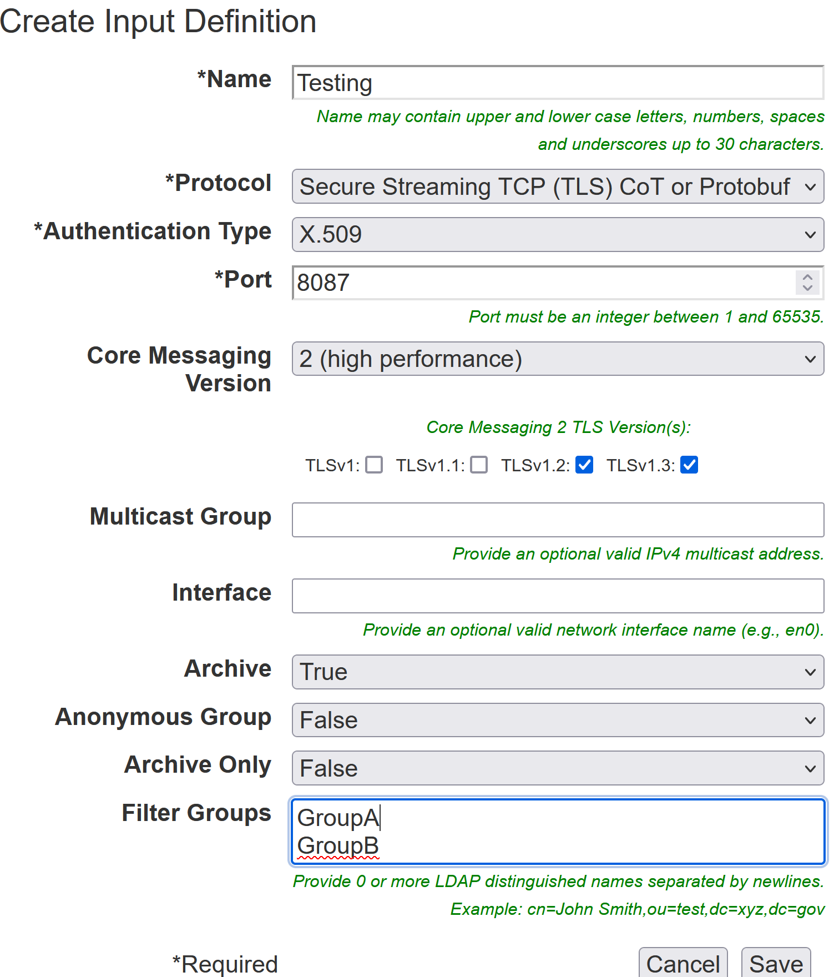
TAK Server - Using Input Based Grouping
Open the admin dashboard → hamburger menu → Configuration →Input and Data Feeds.
Select “Add Input (Server Port)” :
Name: (Your Choice) → Testing
Protocol: Standard Streaming TCP (TLS)
Authentication Type: X.509
Port: (The port you configured) → 8087
Filter Groups: GroupA
These can be new groups or existing groups from other ports.
You are able to add multiple groups but add each to their own line.
Select “Save”
Notes:
# Note the authentication type needs to be set to “anonymous” for the groups that are connected to show up in the dashboard.

Slide 15
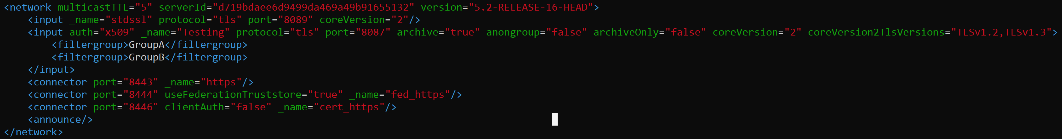
TAK Server - Using Input Based Grouping - Command Line
Adding inputs editing the Core Configuration file:
Navigate to and open the CoreConfig.xml file
cd /opt/tak
vi CoreConfig.xml
In-between our <network> </network> section add the following:
<input auth=“x509" _name=“Testing" protocol="tls" port="8087" archive="true" anongroup="false" archiveOnly="false" coreVersion="2" coreVersion2TlsVersions="TLSv1.2,TLSv1.3">
<filtergroup>GroupA</filtergroup>
<filtergroup>GroupD</filtergroup>
</input>
You can change the values as you desire to add different groups or change the port type.
Notes:
# Note the authentication type needs to be set to “anonymous” for the groups that are connected to show up in the dashboard.

Slide 16
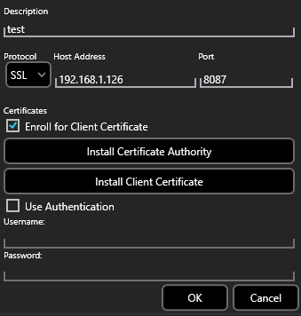
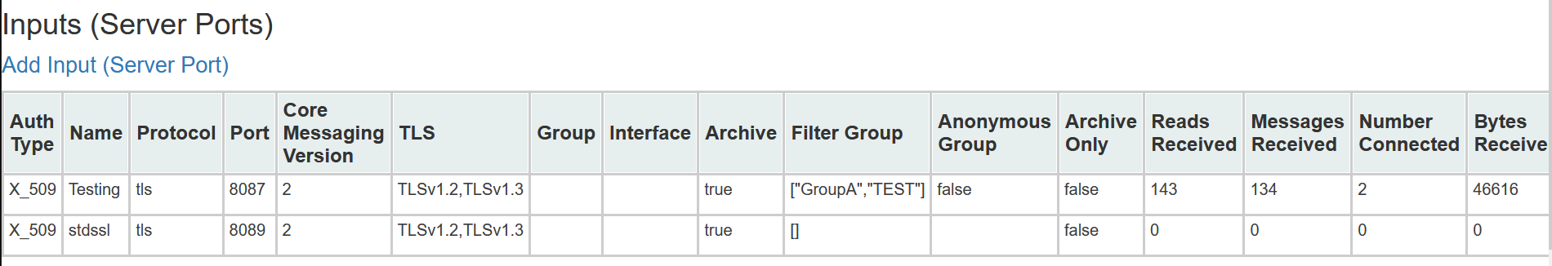
TAK Server - Input Based Grouping - Connection
When attempting to connect a TAK device you will follow the standard process but update the port option to that of the configured one.
Once connected you can verify the settings and number of connected devices from the “Inputs and Data Feeds” panel.
Notes:
# Note the authentication type needs to be set to “anonymous” for the groups that are connected to show up in the dashboard.

